Slide 1
Explanatory Data Analysis on Shopping Trends
Mentor’s Name: Jaya Pandey
Student’s Name: Sindupriya Itha

Slide 2
Steps to perform in EDA of Shopping Trends
Collecting the dataset.
Understanding the data: Performing Level Analysis
Performing Level 1 Analysis: Univariate Analysis
Performing Level 2 Analysis: Bivariate Analysis
Performing Level 3 Analysis: Multivariate Analysis
concluding the data.

Slide 3
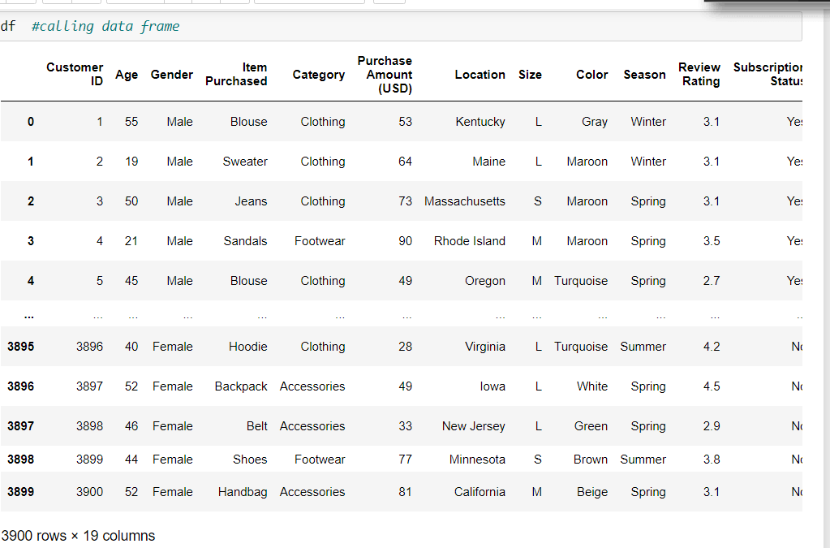
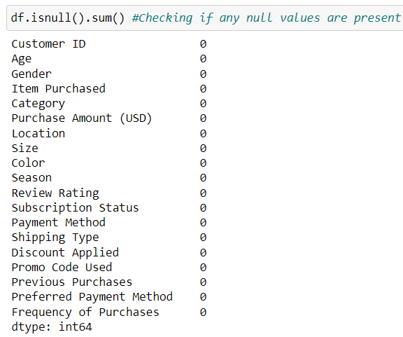
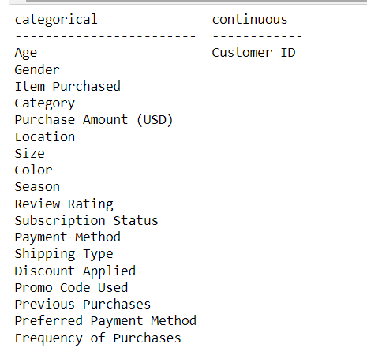
Level 0 Analysis: Understanding the dataset
.
The detailed information of the dataset is being displayed.
There are no null and missing values.
Data is segregated into categorical and numerical data

Slide 4
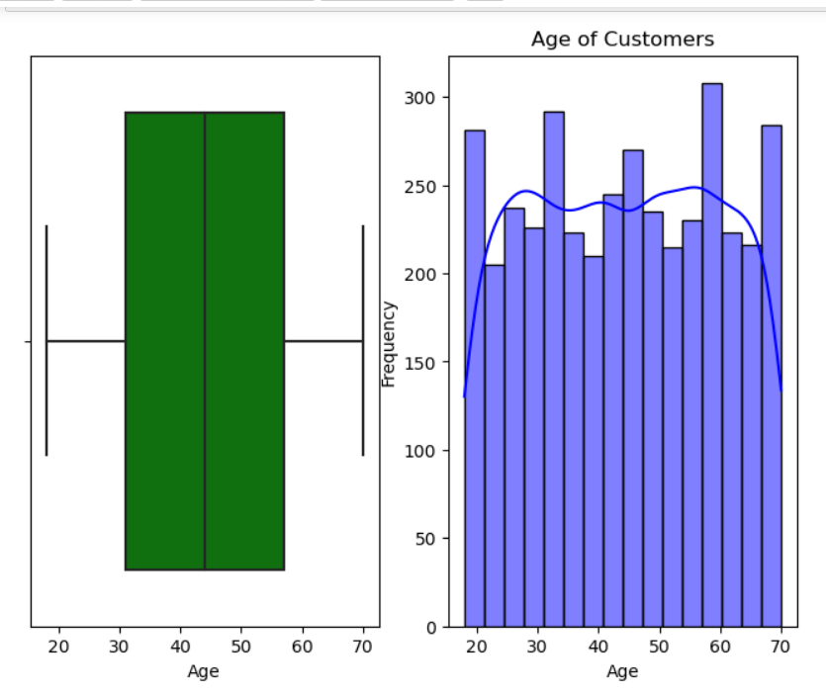
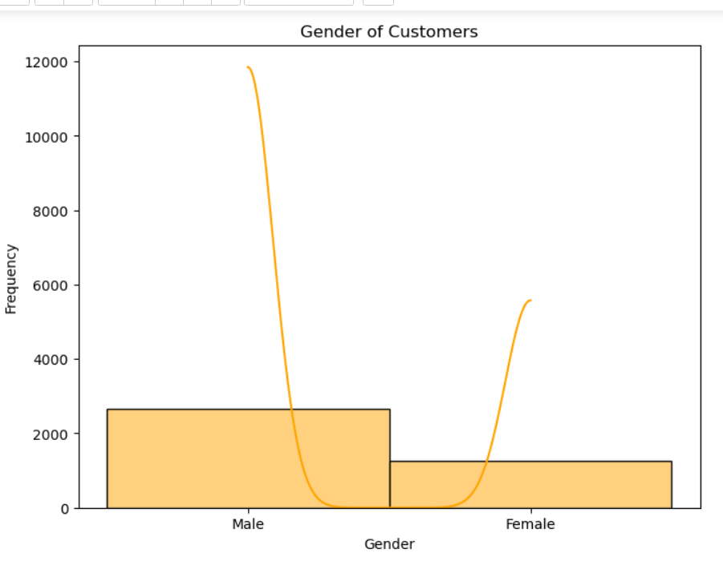
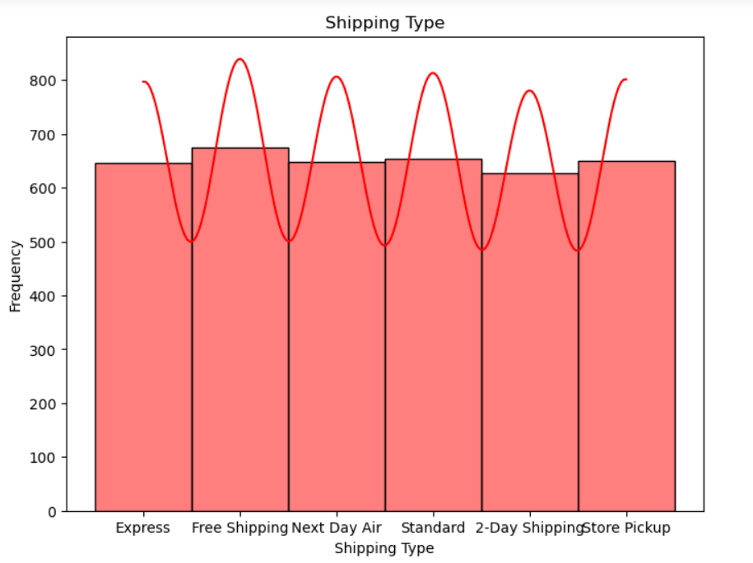
Level 1 Analysis: Univariate Analysis
.
Interpretation: Customer Age group is widely distributed between age group 20 to 70
Does customer gender influences shopping trends?
Interpretation: Male customers shop more than female customers
How does shipping method influences customer shopping trends?
Interpretation: customers are shopping in all possible means of delivery. From pickup,freeshipping, paid, to Air Shipping.

Slide 5
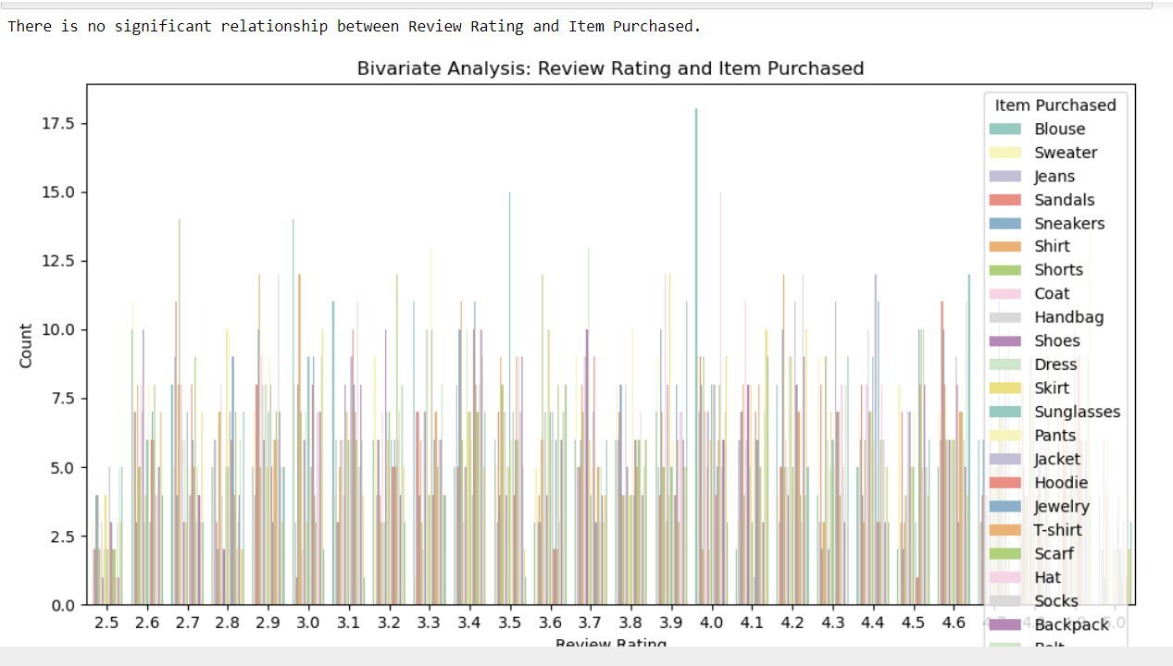
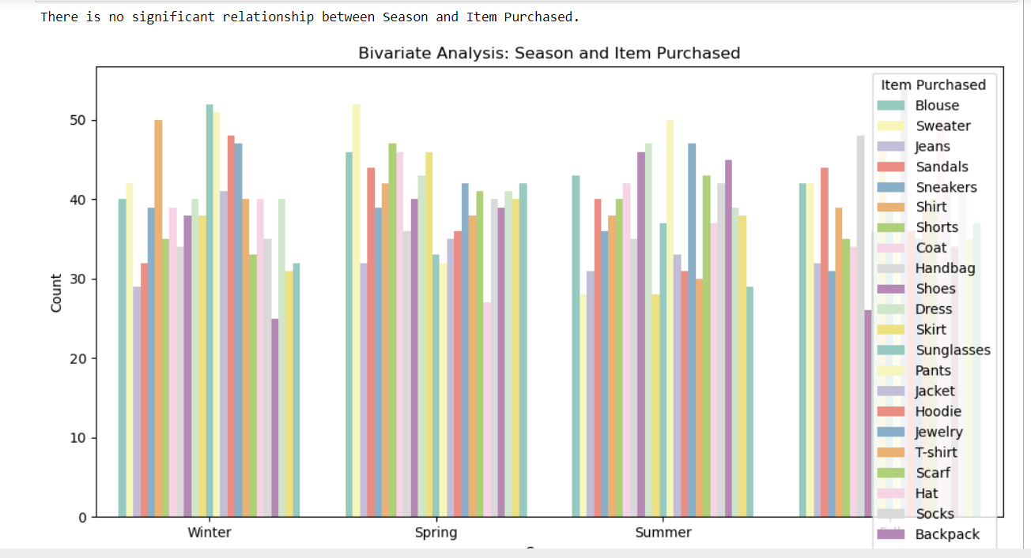
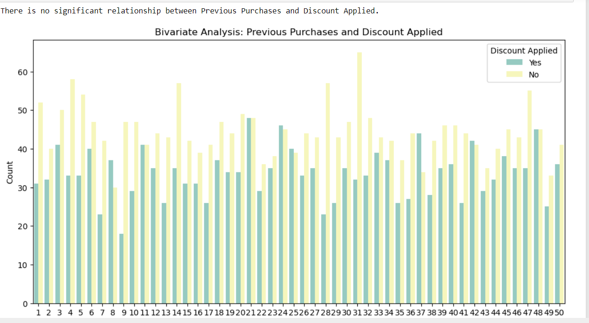
Level 2 Analysis: Bivariate Analysis

Slide 6
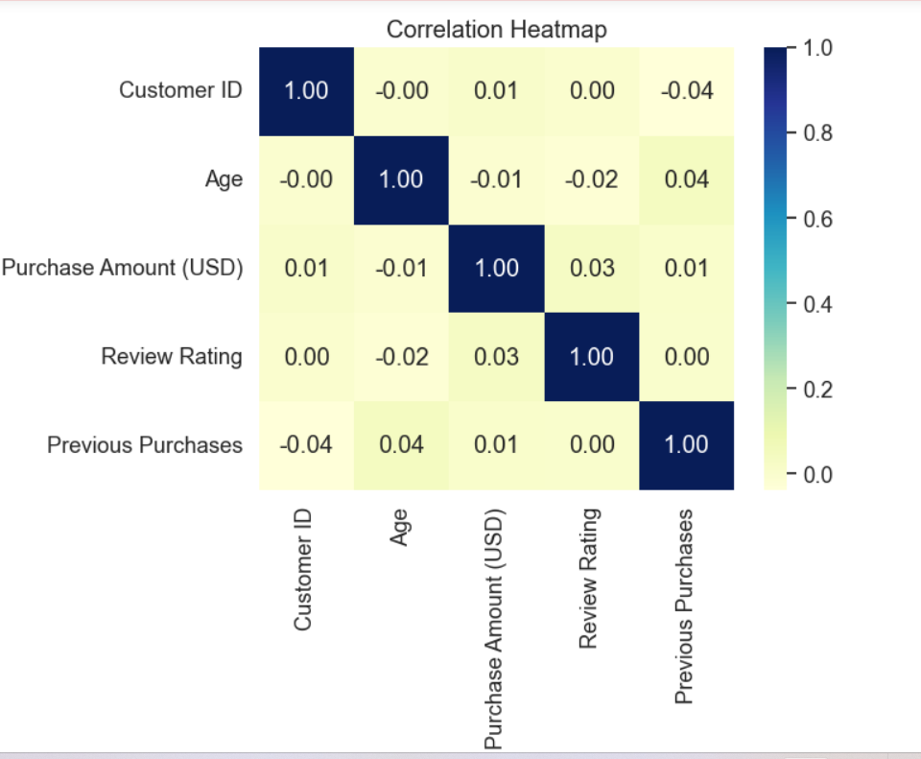
Level 3 Analysis: Multivariate Analysis
Interpretation:
#The correlation between "Age" and “Previous Purchase" is positive.I implies older customers tend to reorder the products
#The correlation between "Age" and "Review Rating" is negative. So it implies that older customers tend to give lower ratings on average.
#The correlation between "Purchase Amount (USD)" and "Review Rating" is positive.Means, customers who spend more on their purchases tend to give higher ratings, #indicating a positive association between spending and satisfaction

Slide 7
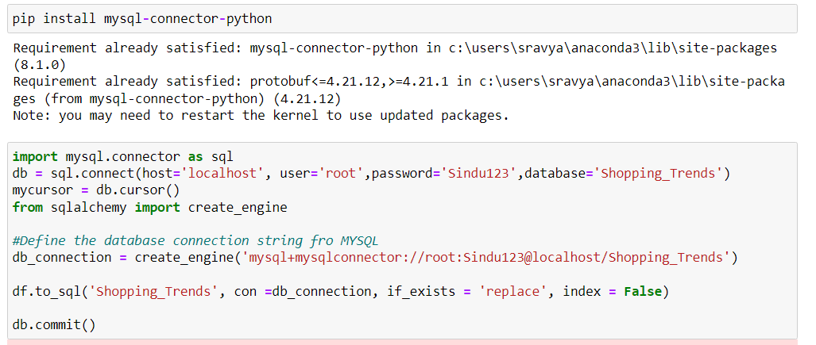
Working on MySQL
Connecting the dataset using Jupyter notebook.
Working on MySQL platform.

Slide 8
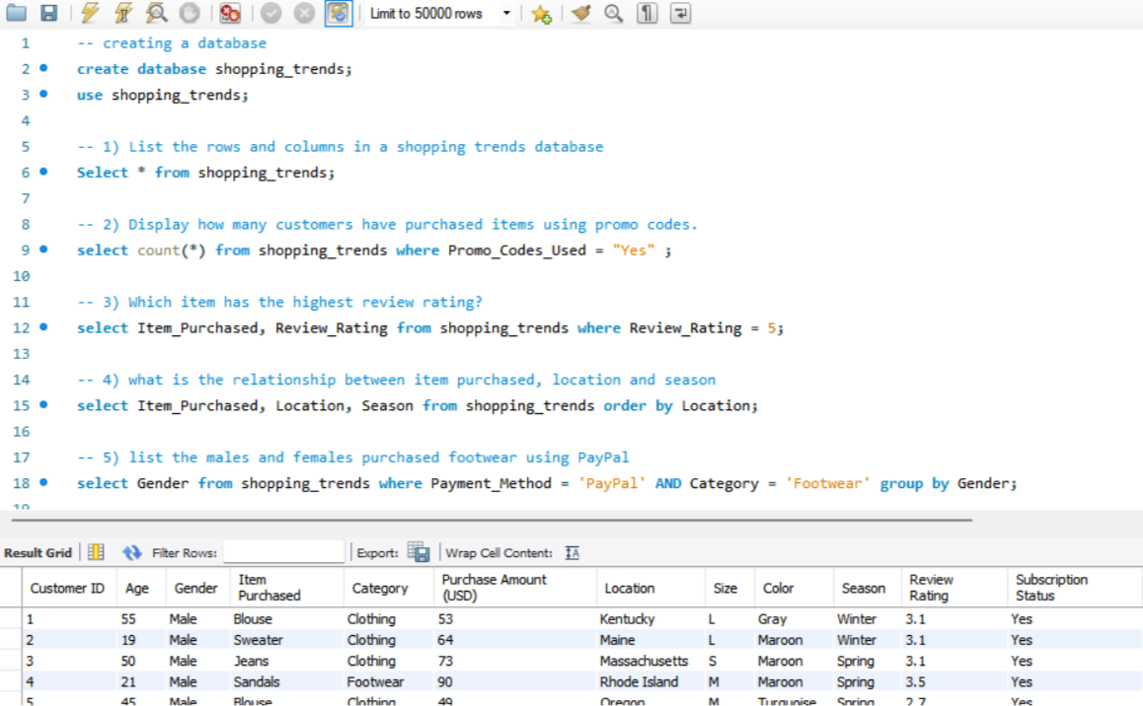

Slide 9
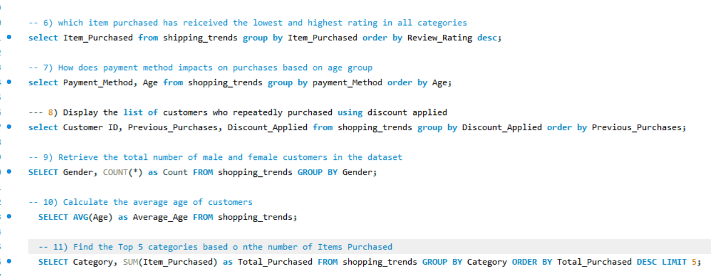
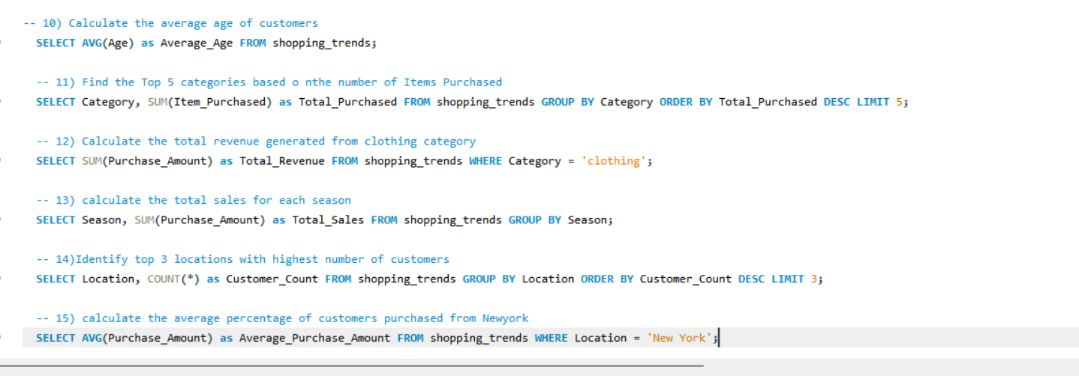

Slide 10
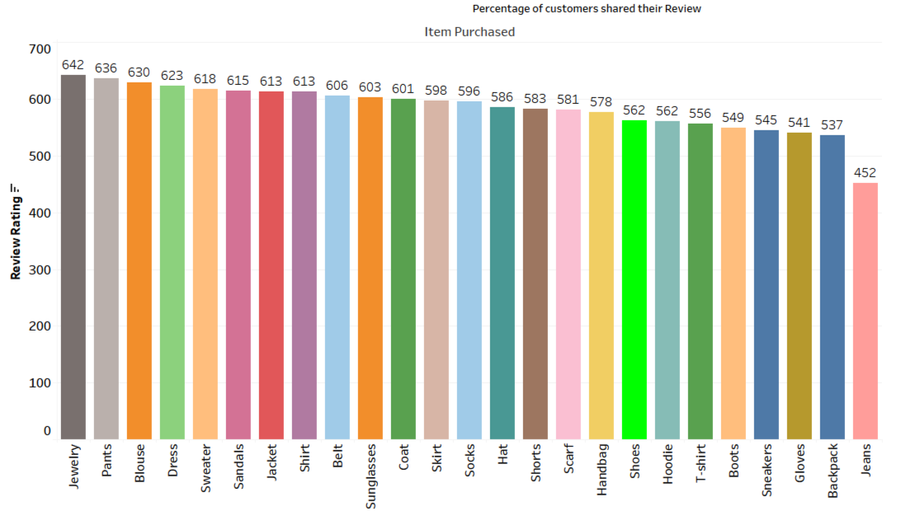
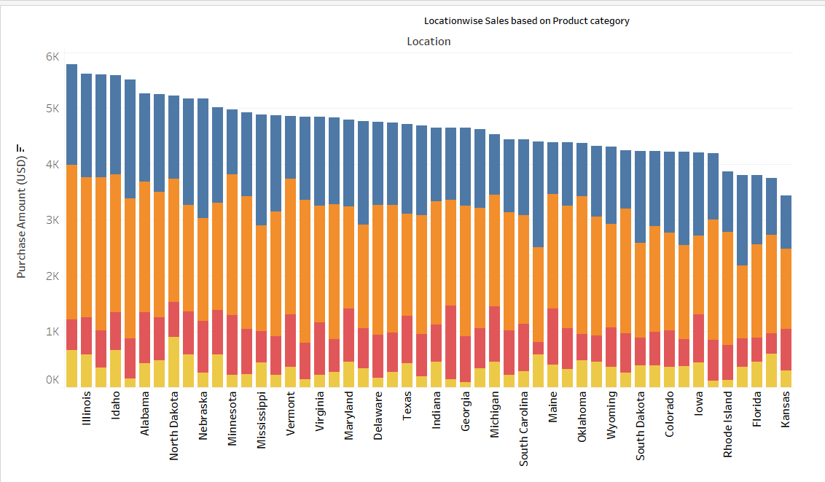
Working on Tableau
Task-1
Columns used: Items Purchased
Rows used: Location
Interpretation: Maximum number of customers shared their level of satisfaction i.e review of products purchased.
Task-2
Columns used: Purchase Amount
Rows used: Location
Interpretation:Sales vary by location based on product category

Slide 11
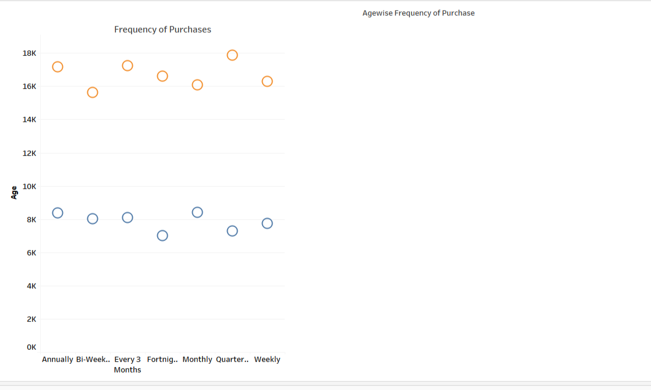
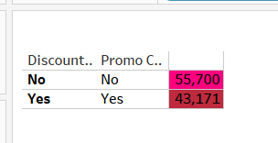
Task-3
Columns used: Frequency of Purchases
Rows used: Age
Interpretation: Frequency of purchase and age has a good replationship
Task 3
Columns used: Discount code, promo code
Rows used: Location
Interpretation: sales did not effect with or without promo and discount codes

Slide 12
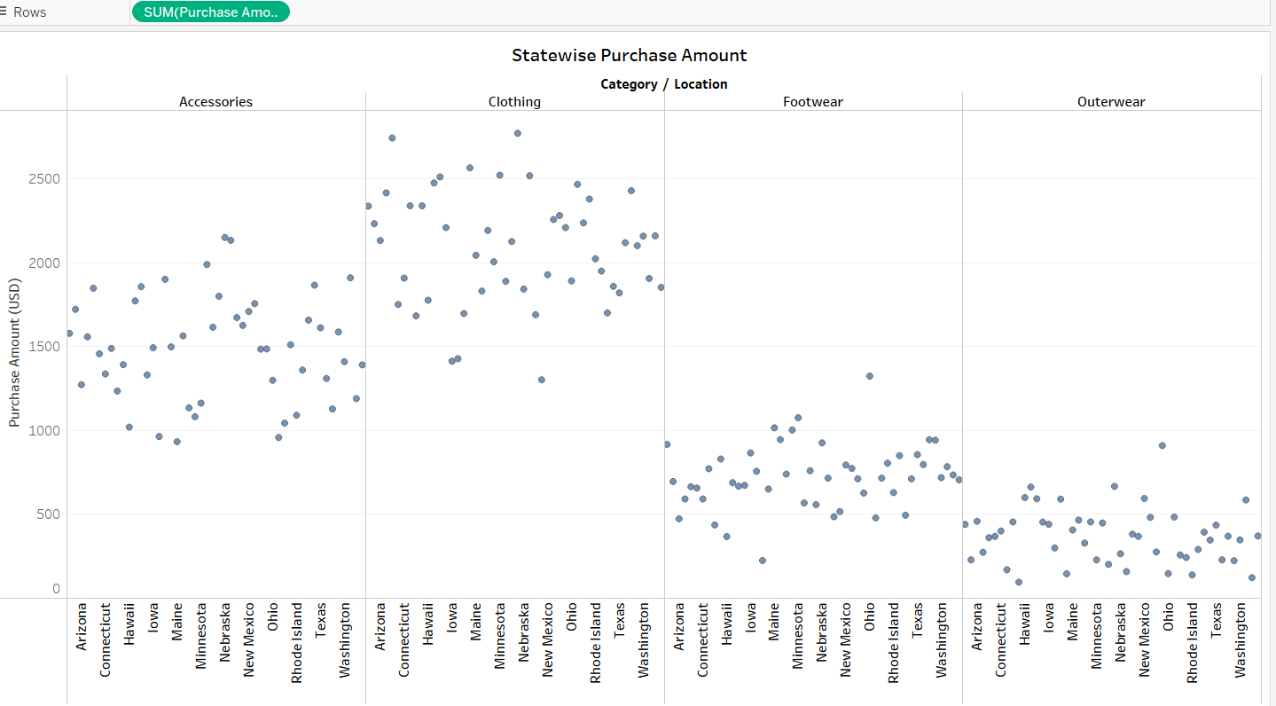
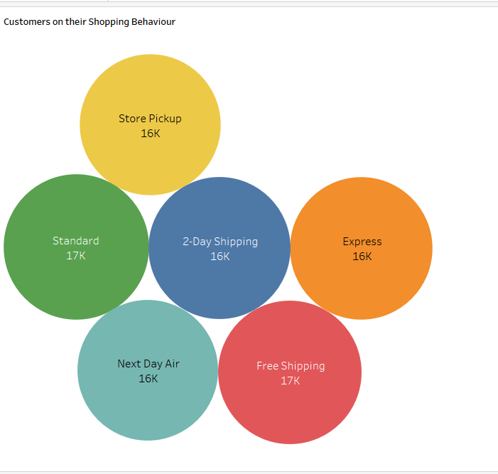
Task-5
Columns used: Purchase Amount, category
Rows used: Location
Interpretation: customer location wise and product category is has major impact on customer behavior
Task-6
Columns used: shipping
Rows used: items purchased
Interpretation: customers shopped with different types of shipping methods

Slide 13
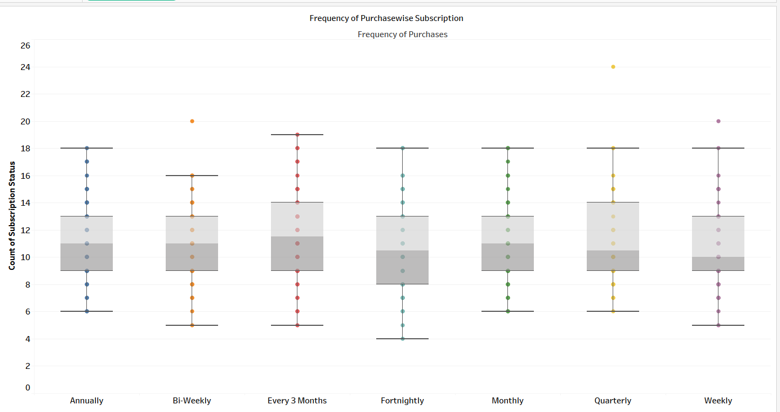
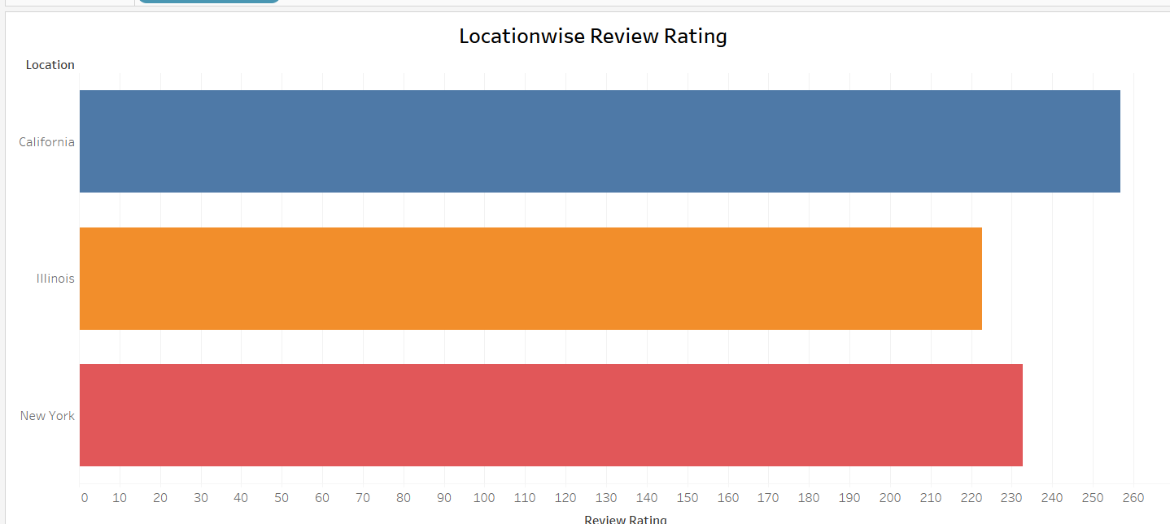
Task-7
Columns used: Frequency Of Purchases
Rows used: Subscription
Interpretation: Location has a major influence on frequency of purchasing
Task-8
Columns used: Review Rating
Rows used: Location
Interpretation: In California people who purchase products write their reviews and Illinois people showed the least interest in writing reviews.

Slide 14
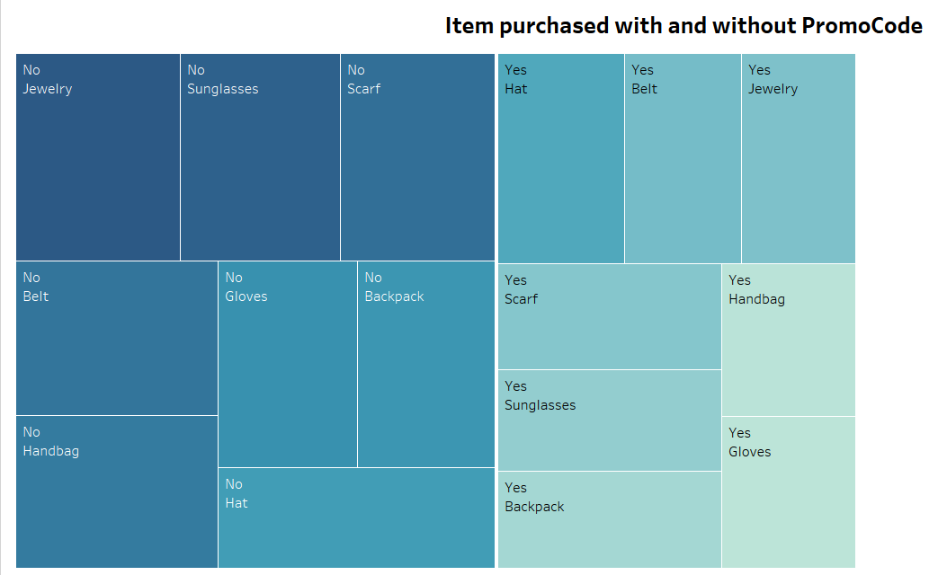
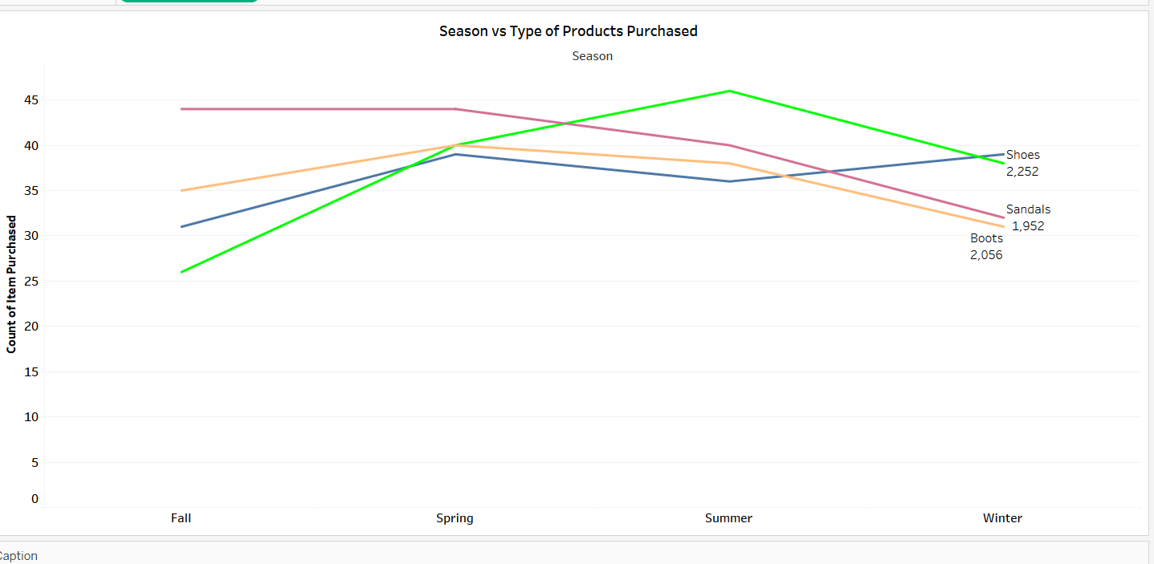
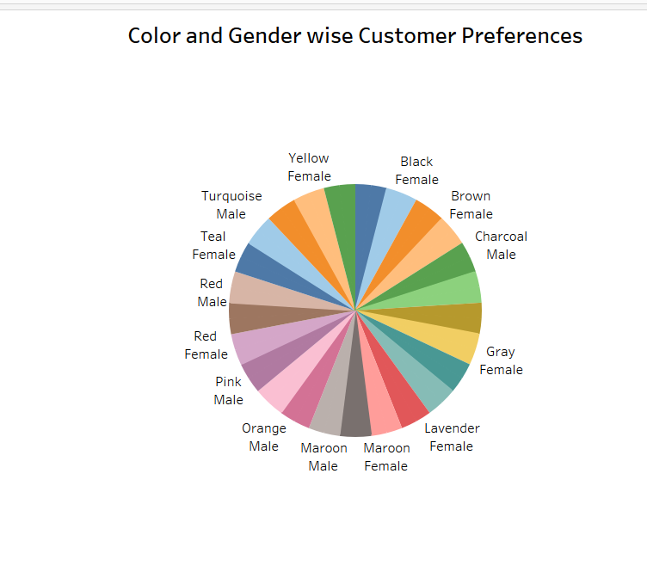
Task-9
Columns used: Items Purchased
Rows used: Promo code
Interpretation: Yes, there is price reduction in all the items for which customers used promo codes.
Task-10
Columns used: Review Rating
Rows used: Location
Interpretation: customer shopped the products based on their Color and gender
Task-11
Columns used: season
Rows used: item purchased
Interpretation: customers purchased products according to their season

Slide 15
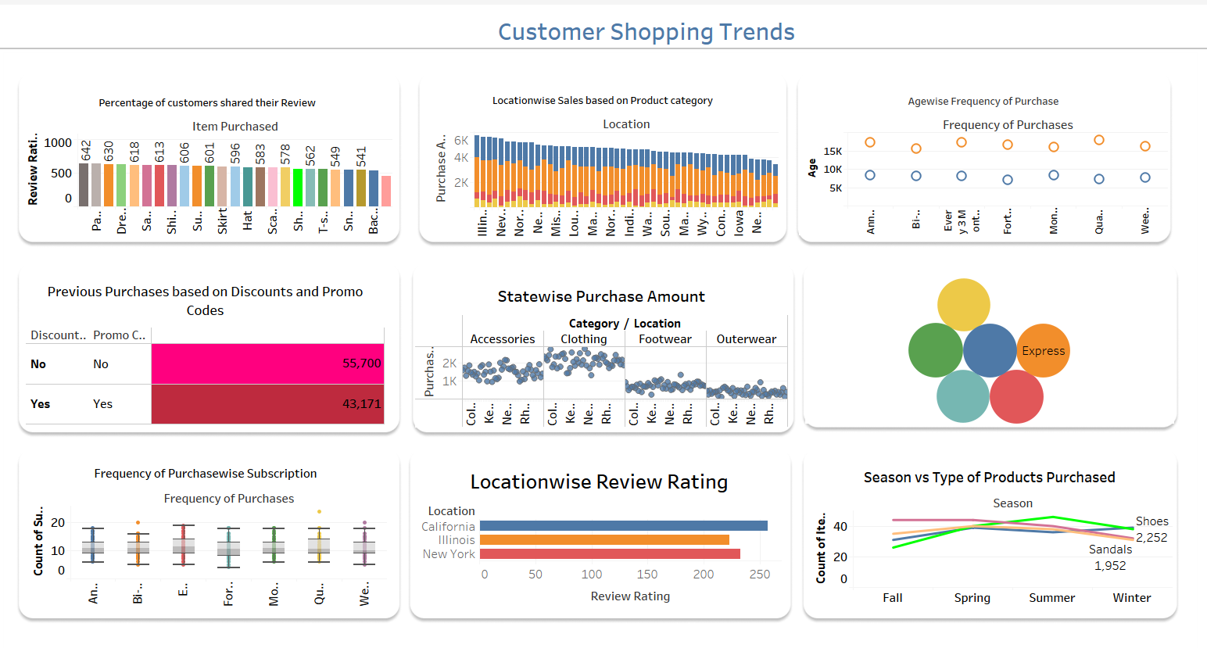

Slide 16
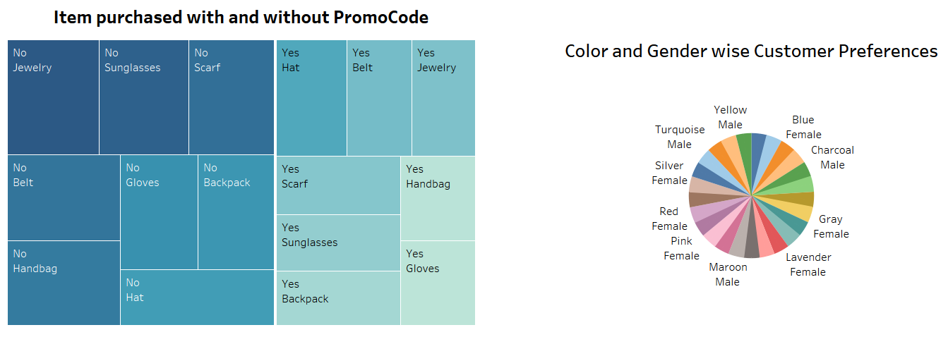

Slide 17
For Python Analysis:
In Python, the univariate analysis provides the information regarding customer shopping trends based on demographics, purchases, and how the shipping methods, discounts, and location. This analysis contribute in improving sales for strategists to make decisions based on customer segments.
The Bivariate analysis provides information on how various factors interact or have relationships to improve sales.
The multivariate analysis provides valuable information for strategists or decision makers as it gives a detailed information on how varies factors relate with each other and have relation-ships.
\
For MySQL Analysis:
Mysql analysis provided valuable information into customer demographics, behavior, satisfaction factors and trends.
The findings explains, based onlocationcustomer preferences has shown difference in shopping behavior.
Also, there is a clear indication that the older the age the higher the percentage of customers gave reviews for their purchased products.
It also clearly indicated that there was only few instances that the customers are fully satisfied with their shopping
For Tableau Analysis:
In Tableau, a comprehensive analysis of dataset have performed, exploring the diverse factors for customer shopping trends.
visualized customer behavior across various dimensions, like, age, gender, location, item purchased, shipping methods, frequency of purchase etc. It revealed that customer age has significant contribution in purchasing, rating, repeated purchasing and using promo codes.
This detailed visualization gives a cut on shopping trends which helps the various departments to improve, and make decisions for further growth.

Slide 18
Thankyou

